Slide 1


LOYOLA UNIVERSITY CHICAGO
Social Enterprises: Innovative Approaches
to 21st Century Challenges
Kathy Getz & Tim O’Connell
CURL Seminar
December 7, 2012

Slide 2
Definition of Social Enterprise
An organization in which the core business activity
produces a benefit to society through a product, labor or process that is beyond the benefit provided to its customers; and
the removal of the benefit to society would substantially alter or eliminate the business.
LOYOLA UNIVERSITY CHICAGO
QUINLAN SCHOOL OF BUSINESS

Slide 3
Features of Social Enterprises
Dual (or triple) bottom-line
Careful attention to multiple stakeholders
Passion for social cause
Rigorous attention to fundamentals (efficiency and effectiveness)
Facility and preference for working collaboratively across sectors
LOYOLA UNIVERSITY CHICAGO
QUINLAN SCHOOL OF BUSINESS

Slide 4
Quinlan School Initiatives
Curriculum
  Entrepreneurship program
  Microenterprise consulting
Co-curricular activities
  Case competition
  Business plan competitions
  Volunteer and service programs
Faculty research
  Benton: sustainable production and consumption
  Getz: peace through commerce
  Shultz: subsistence marketplaces
  Uygur and Marcoux: social entrepreneurship
Outreach and Programming
  Dean’s Speaker Series
  More to come with launch of Baumhart Center
LOYOLA UNIVERSITY CHICAGO
QUINLAN SCHOOL OF BUSINESS

Slide 5
Baumhart Center for Social Enterprise and Responsibility
In the midst of frequent difficulties, [business leaders] will many times be in a position to do much good for many people.
– Raymond C. Baumhart, S.J. (1991)
Promote a conversation about business as a force for good.
Serve as a venue in support of multi-sector collaboration.
Provide guidance for businesses to help them assess the return on investment (especially qualitative) of social responsibility spending.
LOYOLA UNIVERSITY CHICAGO
QUINLAN SCHOOL OF BUSINESS

Slide 6


Slide 7
Evolving Landscape
“Classic” Vision
  Businesses –
    For profit
    Focus on Stockholders
  Social Services –
    Non-profit
    Focus on clients & society
LOYOLA UNIVERSITY CHICAGO
QUINLAN SCHOOL OF BUSINESS

Slide 8
Evolving Landscape
Recent Vision
  Business
    For profit
    Focus on Stakeholders
    “Socially Responsible”
LOYOLA UNIVERSITY CHICAGO
QUINLAN SCHOOL OF BUSINESS

Slide 9
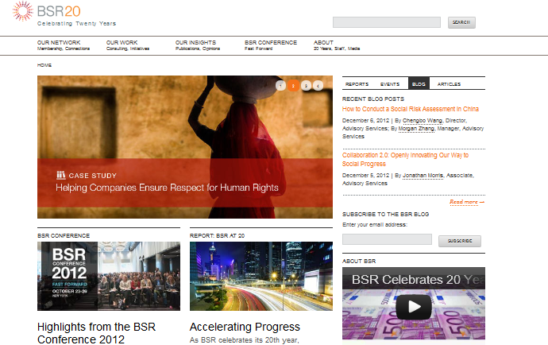

Slide 10
Evolving Landscape
Recent Vision
  Business
    For profit
    Focus on Stakeholders
    “Socially Responsible”
  Social Services –
    Non-profit
    Focus on Stakeholders
    Using business skills for “scalability”
LOYOLA UNIVERSITY CHICAGO
QUINLAN SCHOOL OF BUSINESS

Slide 11
Evolving Landscape
Emerging Vision:
A Continuum of Structures
  Business w/ Social Responsibility
  Business as Social Enterprise
    Benefit Corps
    L3Cs (using PRIs)
  Non-profits w/ For-profit subsidiaries
  Non-profits w/ Business Skills
LOYOLA UNIVERSITY CHICAGO
QUINLAN SCHOOL OF BUSINESS

Slide 12
Current Initiatives
Educational Highlighting
University Collaboration
  CURL
  IUES
  Social Justice Initiatives
  SIFE / ENACTUS
  Moneythink
Outreach
  Social Enterprises
  Business Allies
  Social Service Allies
LOYOLA UNIVERSITY CHICAGO
QUINLAN SCHOOL OF BUSINESS

